Slide 1

Binary Search Trees: Search Trees
Saif Hassan
Department of Computer Science
Sukkur IBA University
Data Structures
Ref: Data Structures and Algorithms Coursera Slides

Slide 2
Agenda
Array Search
The search tree structure

Slide 3
Learning Objectives
Describe how a Binary Search Tree data structure is constructed.
Determine whether a tree is properly sorted.

Slide 4
Last Time
Want data structure for local search.

Slide 5
Last Time
Want data structure for local search. None of the existing data structures work.

Slide 6
Last Time
Want data structure for local search. None of the existing data structures work.
Sorted arrays can search but not update.

Slide 7
Agenda
Array Search
The search tree structure

Slide 8
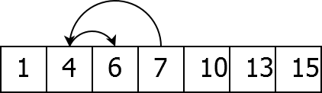
Binary Search
Search an array:

Slide 9
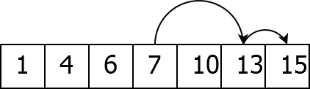
Binary Search
Search an array:

Slide 10
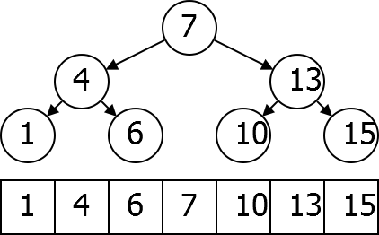
Search Tree
Consider questions asked:
The search tree is much easier to insert into.

Slide 11
Agenda
Array Search
The search tree structure

Slide 12
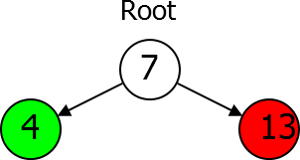
Parts of a Tree
Root node.
Left subtree smaller keys.
Right subtree bigger keys.

Slide 13
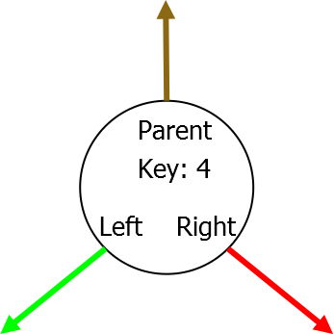
Tree Node Data Type
Key Parent Left Child
Right Child

Slide 14
Search Tree Property
X ’s key is larger than the key of any descendent of its left child, and smaller than the key of any descendant of its right child.

Slide 15
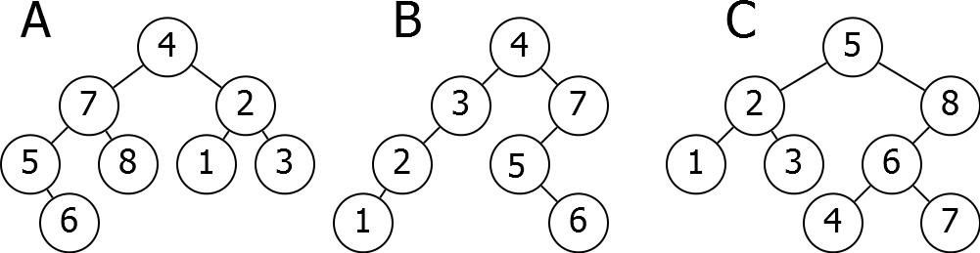
Problem
Which of the following Trees satisfies the Search Tree Property?

Slide 16
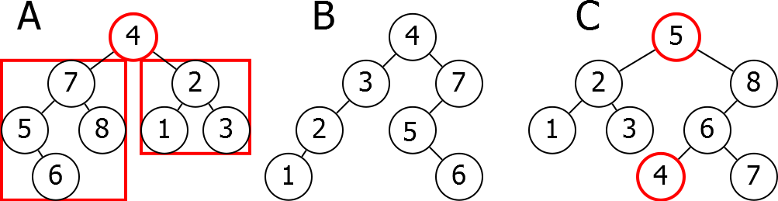
Problem
Which of the following Trees satisfies the Search Tree Property?

Slide 17
Next Time
How to do basic operations on Binary Search Trees.

